Slide 1
Autonomous Ground Control Points Detection
By Kartik Paigwar (BT15CSE038)

Slide 2
What is Photogrammetry?
Photogrammetry is the science of making measurements from photographs. The input to photogrammetry is photographs, and the output is typically a map, a drawing, a measurement, or a 3D model of some real-world object or scene. Many of the maps we use today are created with photogrammetry and photographs taken from aircraft.

Slide 3
What are Ground Control Points?
Ground Control Points (GCP) are points on the ground with known coordinates in the spatial coordinate system (i.e. both coordinates defining horizontal position and the altitude coordinate). Their coordinates are obtained with traditional surveying methods in the field (tachymetry, GNSS-measurement) or from other available sources.Ground Control Points (GCP) are points on the ground with known coordinates in the spatial coordinate system (i.e. both coordinates defining horizontal position and the altitude coordinate). Their coordinates are obtained with traditional surveying methods in the field (tachymetry, GNSS-measurement) or from other available sources.

Slide 4
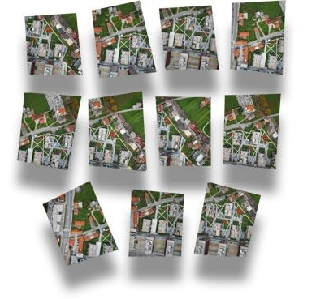
Why are GCPs needed in photogrammetry?
The GCP in nature determines the position of its aerial photo mage in the coordinate system. To calculate the coordinates for each point on the aerial photography, several ground control points’ coordinates are used and photogrammetric procedures followed.

Slide 5
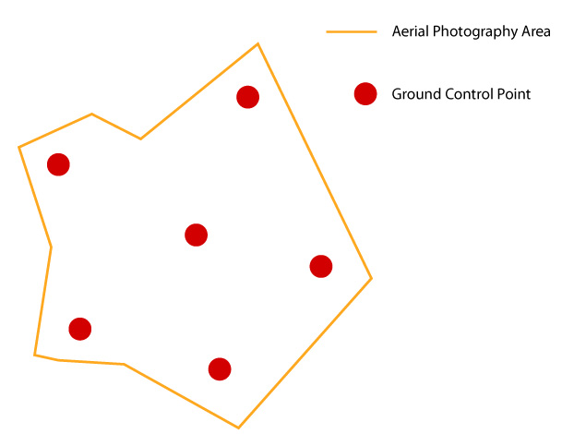
GCPs are necessary for orientation and placement of aerial photographs in the spatial coordinate system, which is a prerequisite for the production of georeferenced metric and 3D models of the earth’s surface (point cloud, DSM, DTM, orthophoto plan). Namely, computer processing and analysis require spatial coordination models – from point cloud to orthophoto mosaics.

Slide 6
Autonomous GCP detection

Slide 7
Approach
Segmentation
GCP Classifier
Ground control point detection

Slide 8
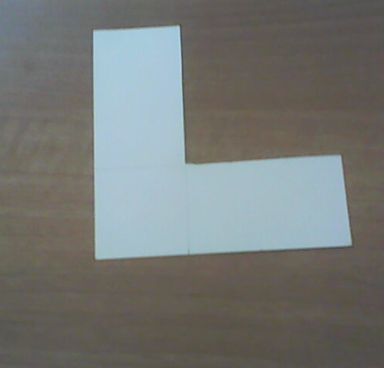
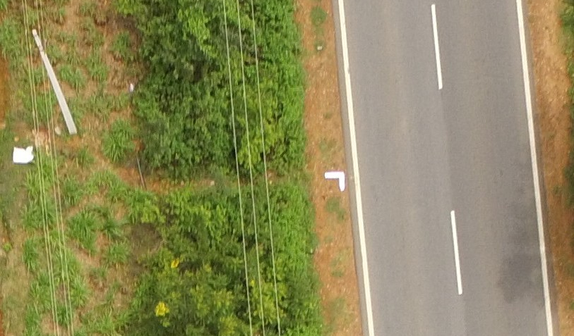
Procedure
Grayscale thresholding
Contour detection
Filter contours based on convexity and area.
Fit Bounding Rectangles on the contours and select bounding rectangles with aspect ratio approximately equal to the square.

Slide 9
GCP Classifier

Slide 10
Binary Image Classifier
Dataset Creation
Positive and Negative examples are collected based on the labeled dataset.
All examples are resized to a uniform size.
Positive examples are augmented( Mirrored, rescaled, rotated) to balance the ratio between negative and positive examples.
Training
Train (60%), Valid(10%), Test(30%)
Convolution neural network architecture with 2 Conv layers and 3 fully connected layers.
Dropout layer with 80% keep probability are being added for better generalisation.
Cross Entropy Loss is used as a training loss

Slide 11
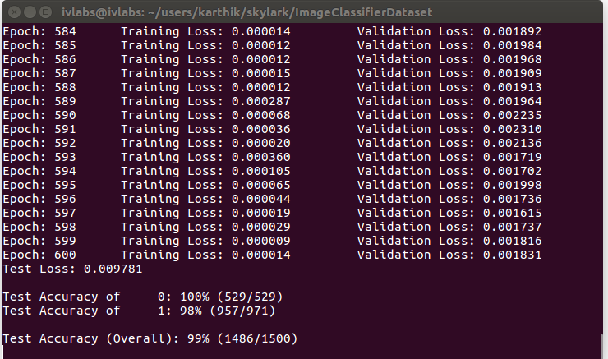
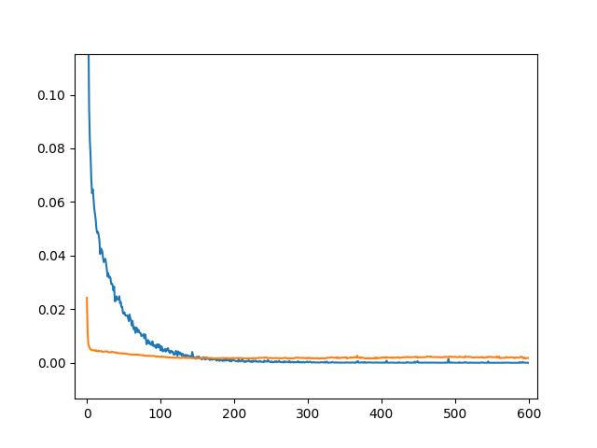

Slide 12
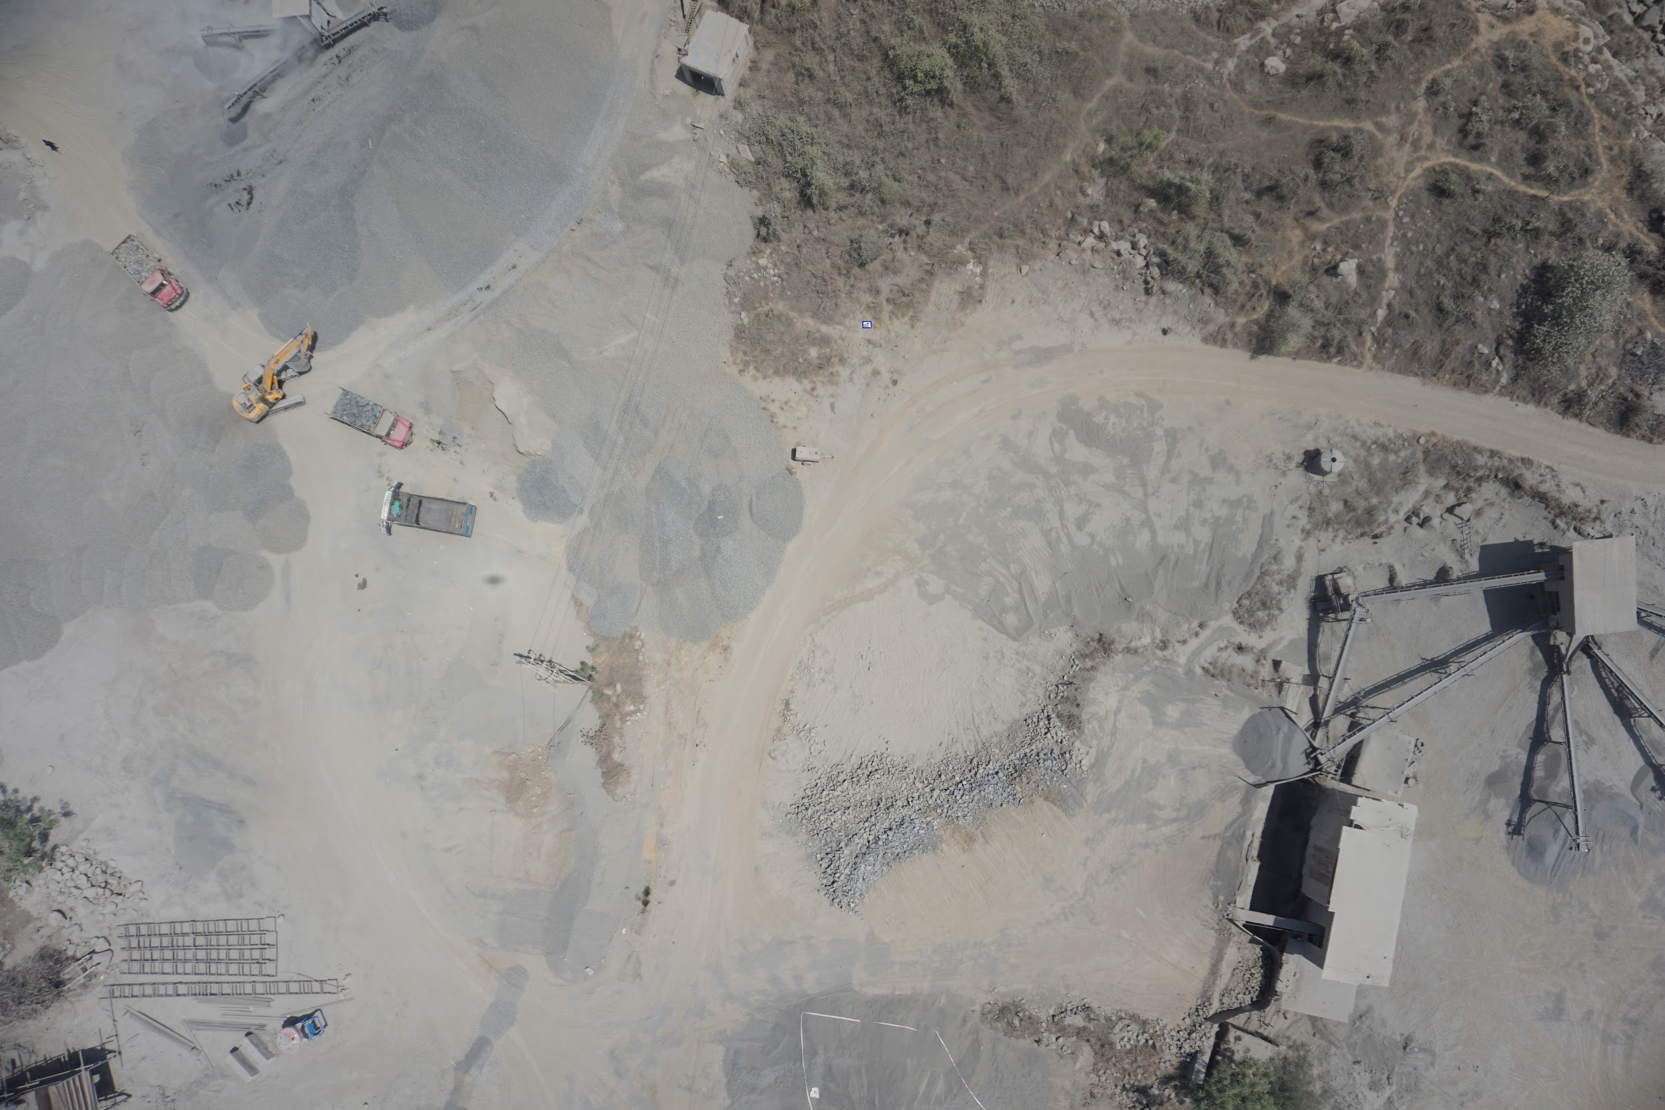
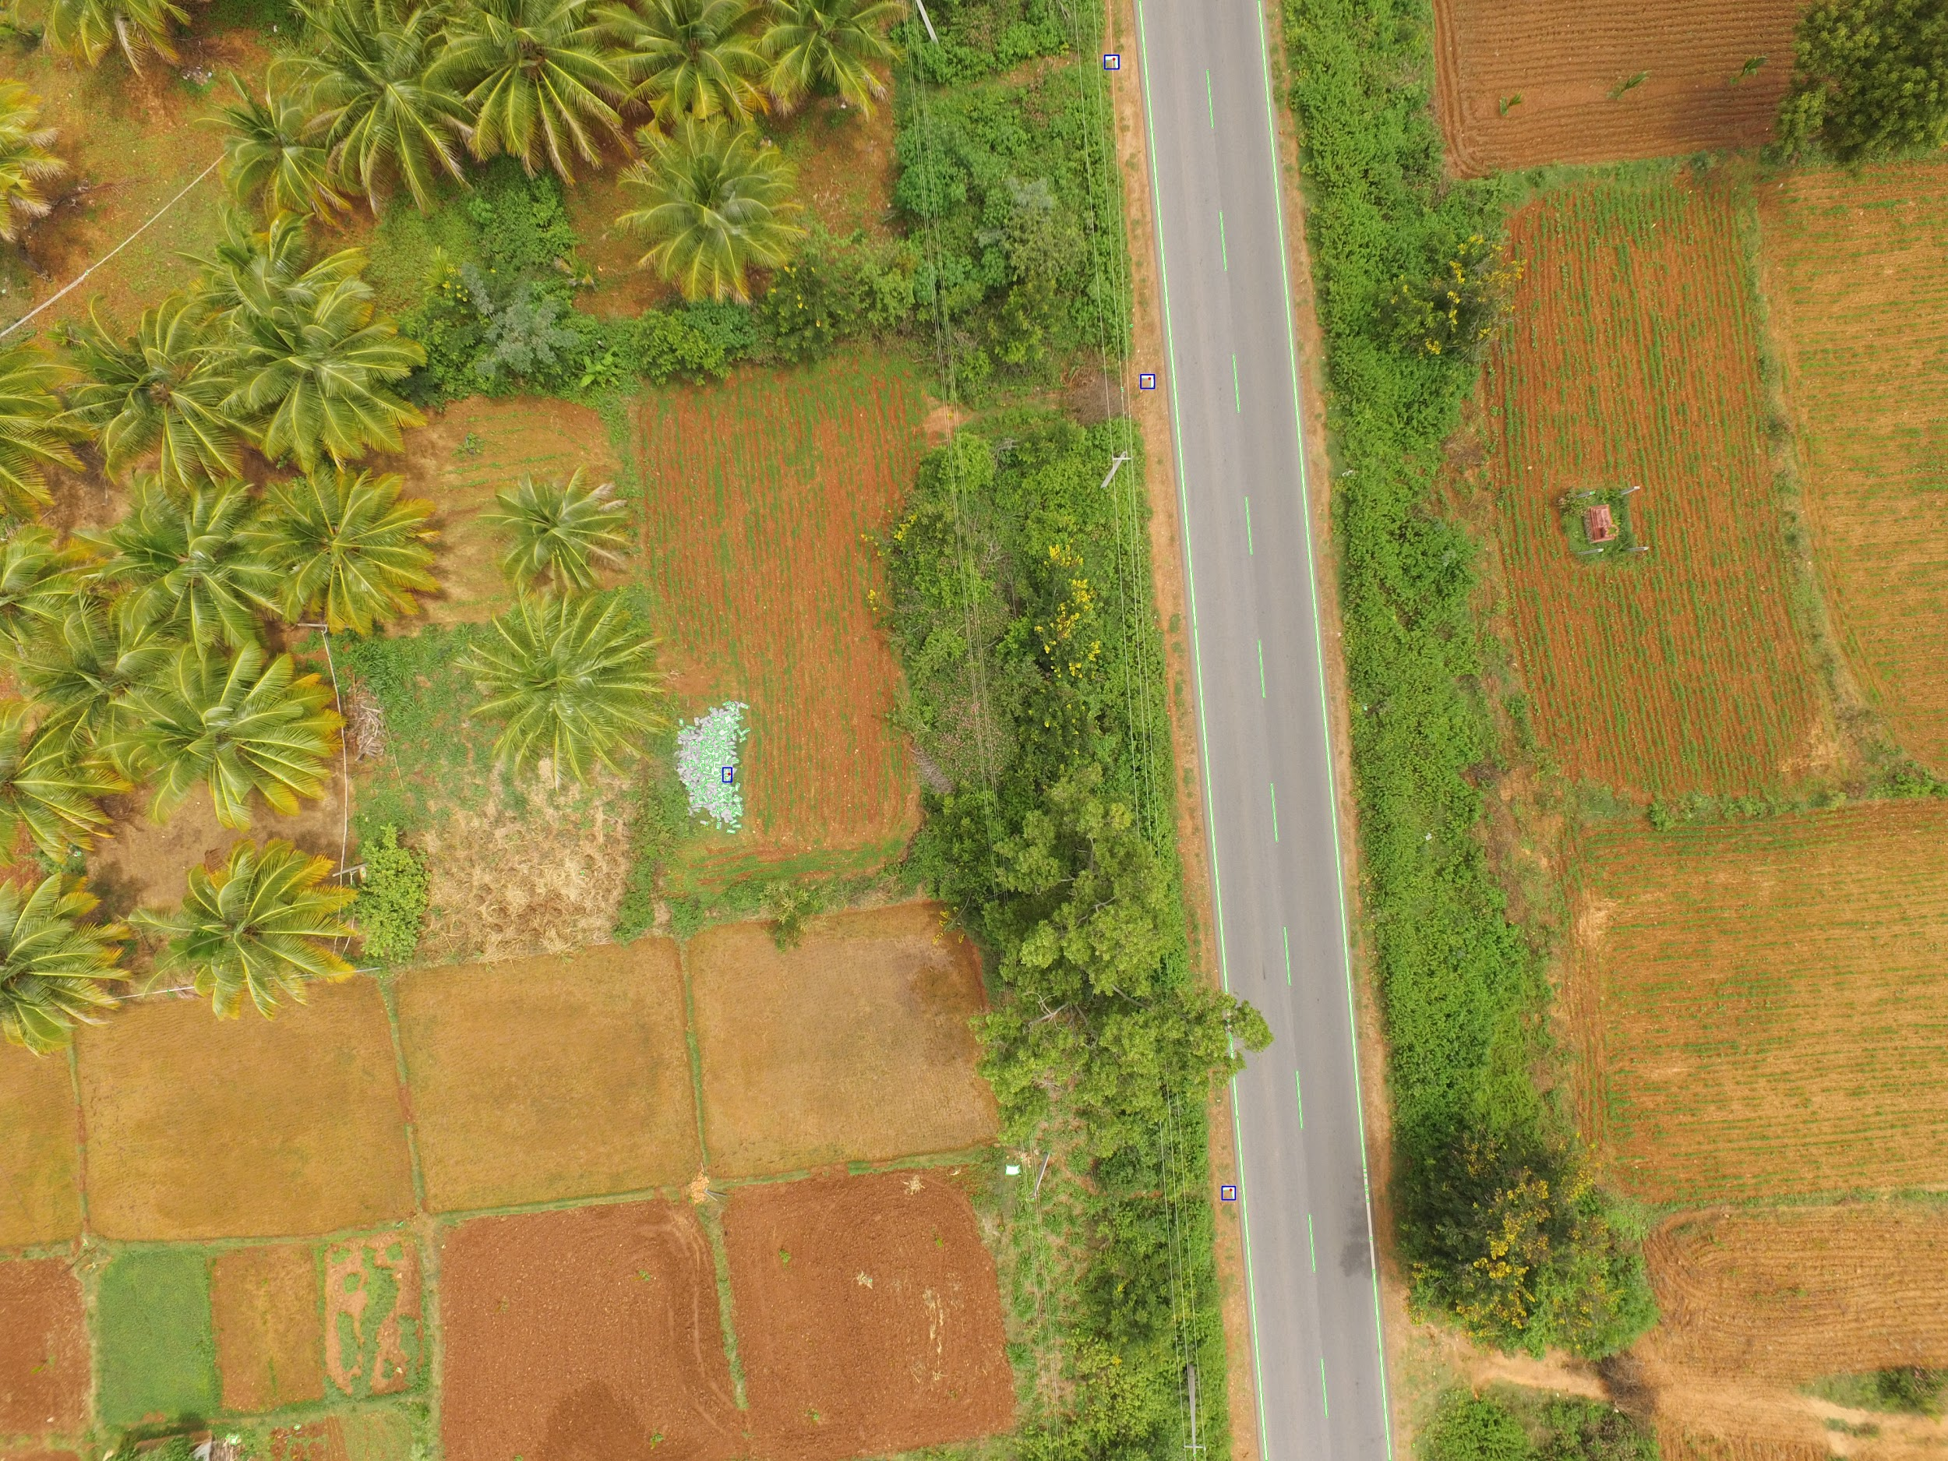

Slide 13
Conclusion
This autonomous GCP detection using Computer vision and machine learning techniques saves a lot of manual time of identifying and marking multiple GCPs in the aerial images shot from the drones for photogrammetry.

